Slide 1

Sixty years of Software development lifecycle
Presented By : Osama Nisar
Roll No : BSCS-F19-M-57
Section : Morning(B)

Slide 2
Introduction
We will discuss the SDLCM and first model was published in 1956.
Provide a structure for the various software development activities to be performed within a project.
Software development process Vs Software development lifecycle.
As programming became more complex, more structure was needed for the development effort.

Slide 3
Literature Review
Name | Author | Method | Conclusion
Process Modeling (February 7, 2017) | B. Curtis, M.I. Kellner, and J. Over, | This framework concentrates on three significant aspects of this process: development, refinement, and serialization the semantics of the process model. | This research concludes that the LORS framework is simple, flexible, visible, interactive, dynamic, and effective.
Hopper and Dijkstra: Crisis, Revolution and the Future of Programming (11 December 2014) | Sandra Payette | The author examines the rhetoric of crisis, revolution, and promise in computer programming cultures by viewing it through the lens of two dissimilar leaders, Grace Hopper and Edsger Dijkstra, | The representatives and exemplars of different communities emphasizes on pragmatic versus theoretical stances, respectively.

Slide 4
Literature Review (Cont..)
Name | Author | Method | Conclusion
Software Processes are Software Too (2011) | Leon Osterweil | The major theme of this meeting is the exploration of the importance of process as a vehicle for improving both the quality of software products and the way in which we develop and evolve them. | It has become increasingly popular to characterize software development as a manufacturing activity in which the final delivered software should be considered to be a manufactured product.
Guidelines for Verifying and Validating Software Requirements and Design Specifications (January 1984) | Barry W. Boehm | The basic objectives are to identify and resolve software problems and high-risk issues early in the software life-cycle. | Making a specific criteria, V&V in the early phases, consistency with work.

Slide 5
Literature Review (Cont..)
Name | Author | Method | Conclusion
No Silver Bullet-Essence and Accidents of Software Engineering (2002) | Frederick P. Brooks, Jr. | accidental tasks inordinately hard, such as severe hardware constraints, awkward programming languages, lack of machine time | In conclusion, now we use high level languages, Time-sharing technique

Slide 6
History
Name | Description
Benington’s Program Production Life Cycle | Problem : As the systems to be developed became more complex, just coding and testing and debugging were no longer sufficient. The requirements were no longer defined from the start but had to be clarified first, and moving from requirements to code was no longer possible in one step. Solution : The main purpose of this model was that Benington explicitly modeled the software development life cycle, defining the life cycle phases and their sequence.(1956)
Hosier’s Program Development Approach | Problem : Not a proper sequencing Solution : It presents the sequence of main activities in a flow chart, those activities described are on a fairly detailed level and do not provide a structure of the development life cycle comparable to that of .(1961)

Slide 7
History (Cont..)
Name | Description
Rosove’s Sequence of Development Stages | Problem : Not Loopbacks Solution : In his “sequence of development stages” Rosove explicitly included feedback loops to previous phases in order to indicate that “knowledge acquired and decisions made in later phases are fed back to earlier phases. (1968)
Zurcher and Randell’s Iterative Multilevel Modeling | Present Iterative and Incremental waterfall-Model

Slide 8
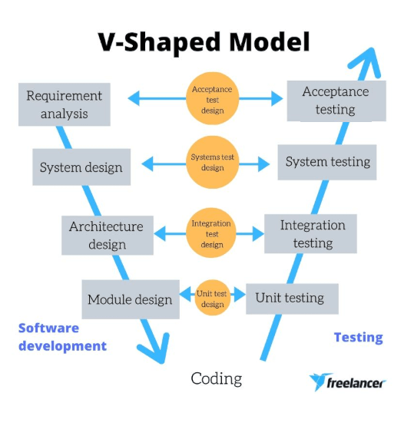
Summary
Until 1970’s, linear approach was pushed by customers who expected to know in advance what they would get as a result from a project and how much it was going to cost. If this was not successful, one tried to improve the requirements analysis methods rather than accepting that changes during a running project were to be expected.
In 1980’s and early 1990’s, two new methods were introduced.
1.
2.
Formal Methods and Cleanroom
Software Engineering
Cleanroom emphasizes defect prevention rather than defect removal.
Formal methods use mathematical and logical formalizations to find defects early in the software development lifecycle.

Slide 9
Summary (Cont...)
In 1990’s to 2000’s, Plan driven vs agile development.
In Plan-driven development, all the actions are planned,
Agile development is a process where all the activities are planned step by step and can change the plan as per the client’s requirements.
RUP approach to software development, published by the Rational Company in 1998,
Inception Phase, project’s basic ideas and structure will be determined to prepare a business suite,
Elaboration Phase, During this phase, to analyze the project’s requirements and necessary architecture, i.e. to review the problems, develop the project plan and architect, and eliminate the high-risk elements from the project.

Slide 10
Summary (Cont...)
In Construction Phase, the project is developed and completed. Here all the features are developed and integrated into the product, i.e. the software is designed, written, and tested successfully.,
In Transition Phase, During this phase, the software is released and delivered to the public or customers. Based on the feedback from the end-users, the product will be made update or change. It is the process of deployment.
Today, we have a great variety of software processes and life cycles,
A very great technique name “agile scaling” introduced.

Slide 11
Conclusion
In 1970’s, a focus on development methods, structured development etc. usually resulted in sequential SDLCMs.
In 1980’s, growing focus on processes, strong control, tool support, inclusion of supporting processes, etc.
1990’s and early 2000’s, the counter-movement grows in importance, leading to a rise of agile methodologies and gives the developer freedom to select which task to perform when.
Today, focus on scaling agile; mostly for large scale software development.

